Slide 1
Two-way ANOVA in R
Presenter:
Bipin Poudel
SC3L Consultant
Department of Statistics
University of Nebraska-Lincoln

Slide 2


More at: https://statistics.unl.edu/sc3lhelp-desk/

Slide 3
Workshop Duration:
60 minutes
Workshop Objectives:
By the end of this workshop, participants will be able to:
Understand the principles of Two-Way ANOVA.
Identify when to use Two-Way ANOVA.
Interpret main effects and interaction effects.
Perform a Two-Way ANOVA in R.
Estimate means and their standard errors
Perform mean comparisons.
Interpret the results

Slide 4
Introduction
What is ANOVA?
Known as Analysis of Variance
Comparison of means across multiple groups.
Extends the idea of t-test to more than two groups.
Why Two-Way ANOVA?
Analyzing the effect of two independent variables on a continuous dependent variable.
Example: Studying the effect of Diet (A, B, C) and Exercise Level (Low, Medium, High) on Weight Loss.
Questions:
What are the independent factors in the above example?
Are they categorical or continuous?
How many levels?
What is the response of interest?
Over which factor do the experimenter has control?

Slide 5
Assumptions:
Normality of residuals.
Homogeneity of variance.
Independence of observations.

Slide 6
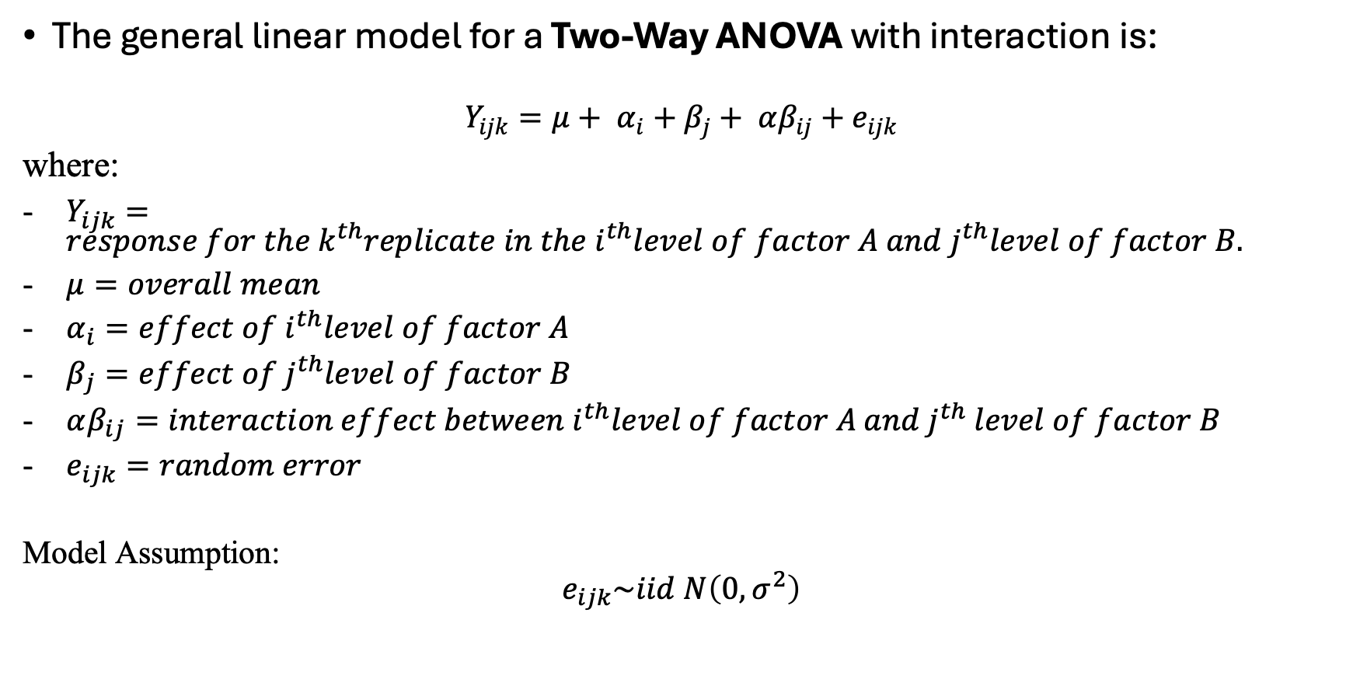
Model
The general linear model for a Two-Way ANOVA with interaction is:
$$Y_{ijk}=μ+ α_{i}+β_{j}+ αβ_{ij}+e_{ijk}$$
where:
$Y_{ijk}=response for the k^{th}replicate in the i^{th}level of factor A and j^{th}level of factor B.$
$μ=overall mean$
$α_{i}=effect of i^{th}level of factor A$
$β_{j}=effect of j^{th}level of factor B$
$αβ_{ij}=interaction effect between i^{th}level of factor A and j^{th} level of factor B$
$e_{ijk}=random error$
Model Assumption:
$$e_{ijk}\sim iid N\left(0, σ^{2}\right)$$

Slide 7
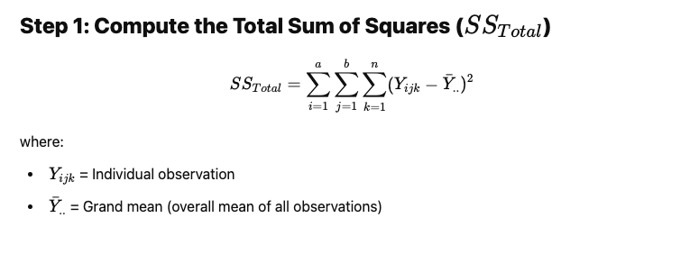
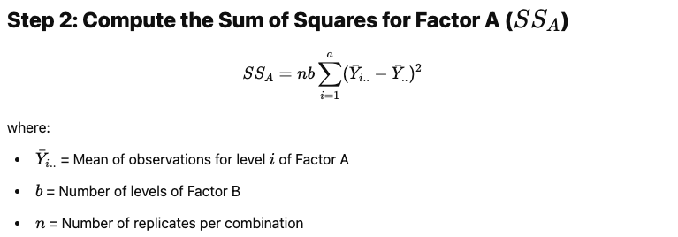
Various Sum of Squares

Slide 8
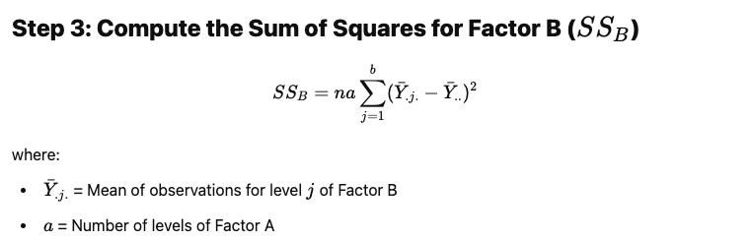
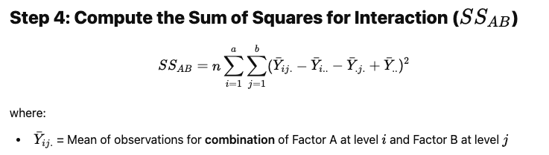
Various Sum of Squares (…contd)

Slide 9
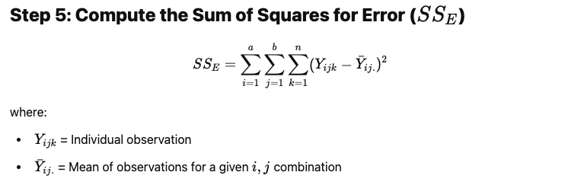
Various Sum of Squares (…contd)

Slide 10
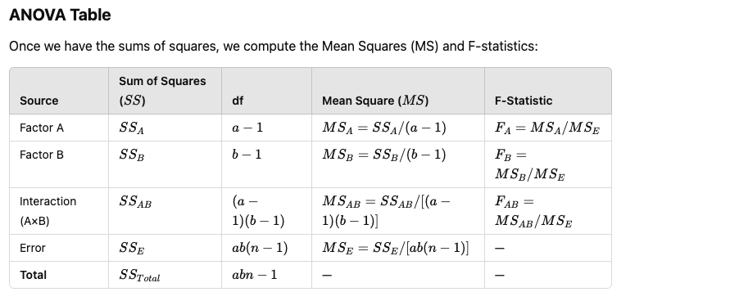
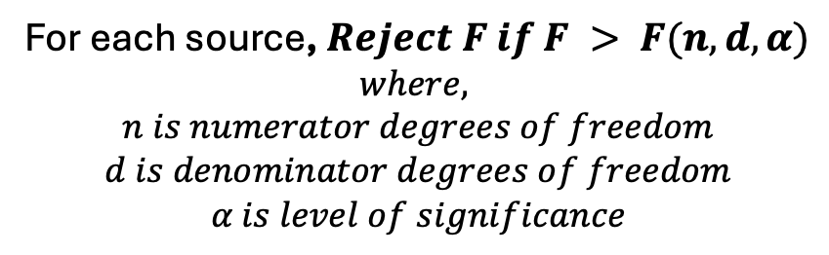
ANOVA Table
For each source, $Reject F if F > F(n, d, α)$
$$where,$$
$$n is numerator degrees of freedom$$
$$d is denominator degrees of freedom$$
$$α is level of significance$$
Alternatively, if the p-value associated with a factor/source is less than ⍺, then conclude statistical significance.

Slide 11
Main effects
A main effect is the overall significance of one factor on the response variable, averaging over the levels of other factors.
Example: If Factor A increases yield regardless of Factor B, then Factor A has a main effect.
Visual Clue:
In an interaction plot, main effects appear as vertically separated but roughly parallel lines.

Slide 12
Interaction Effect
An interaction effect occurs when the effect of one factor depends on the level of another factor.
Example:
If a treatment increases yield at one location but decreases it at another, there’s an interaction between Factor A and Factor B.
Visual Clue:
In an interaction plot, non-parallel or Crossing lines indicate an interaction.

Slide 13
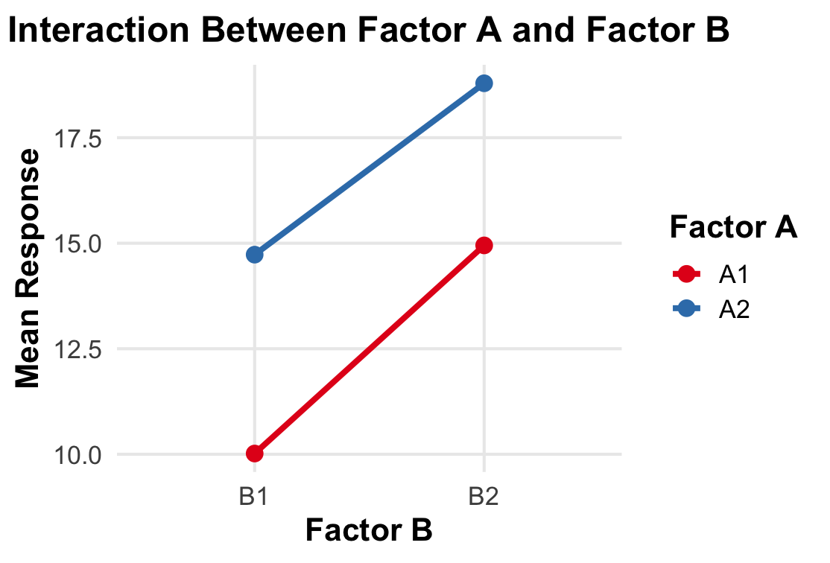
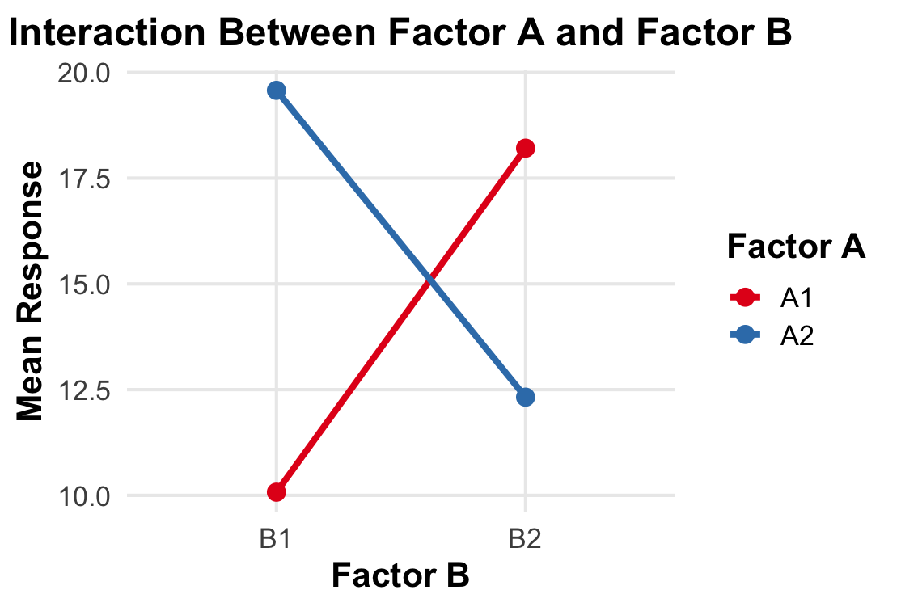
Main effects and Interaction effect
Fig.1: No significant interaction
Fig.2: Significant interaction

Slide 14
ANOVA in R: Example 1
All Categorical Factors:
Study on weight gain of rats fed four diﬀerent diets, where there were two levels of protein (high or low) and two sources of protein (beef or cereal).
This gives 2 x 2 treatment combinations: high/beef (HB), high/cereal (HC), low/beef (LB), low/cereal (LC).
Ten rats were in each of the four treatment groups.
R program: 2by2Qual.R
Response of interest: Weight gain (grams).

Slide 15
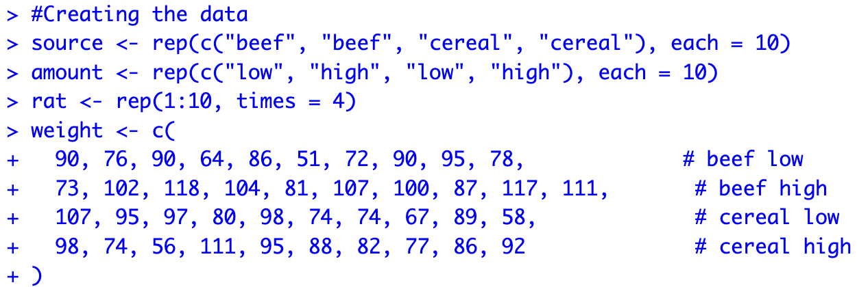
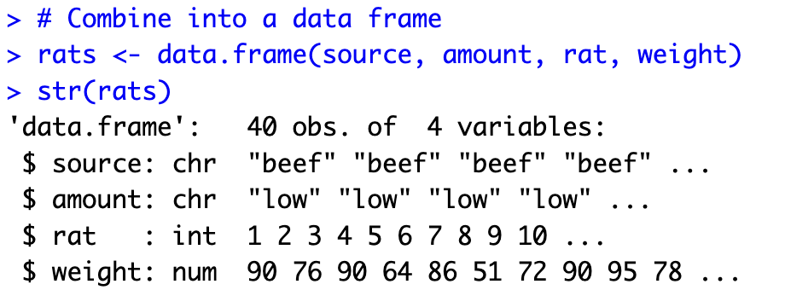

Slide 16
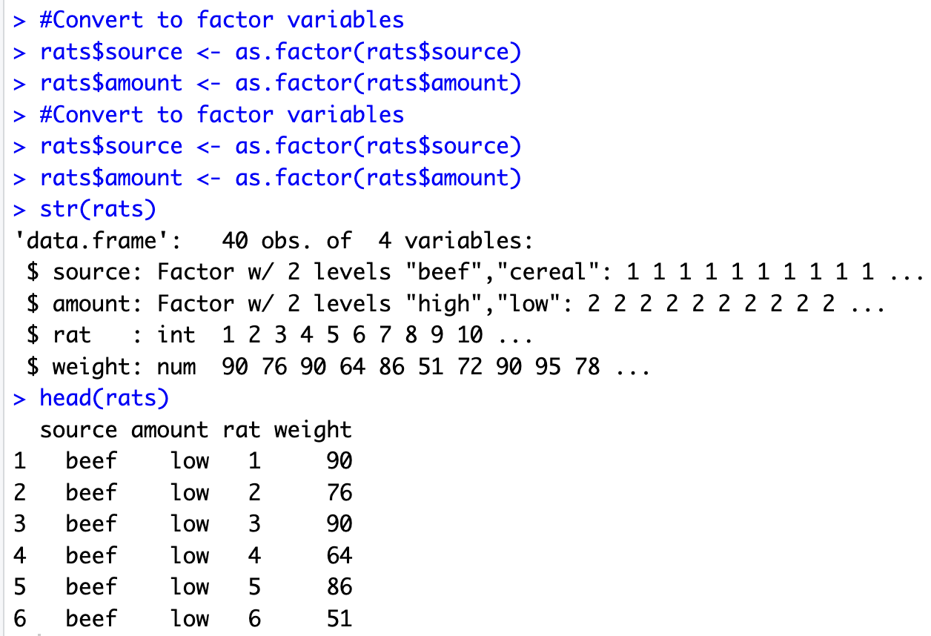

Slide 17
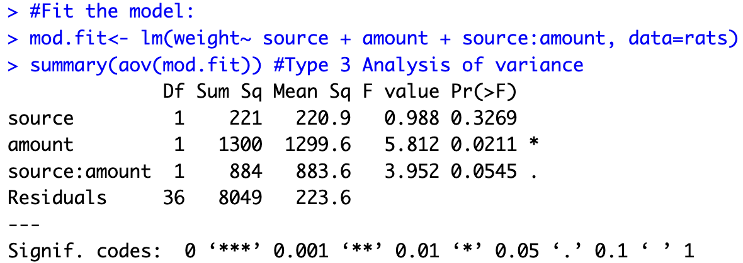
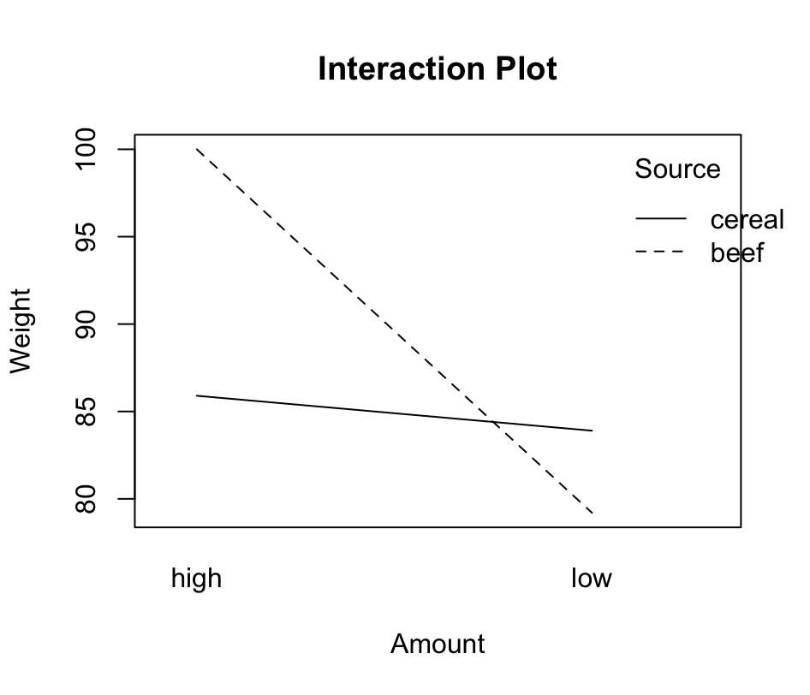
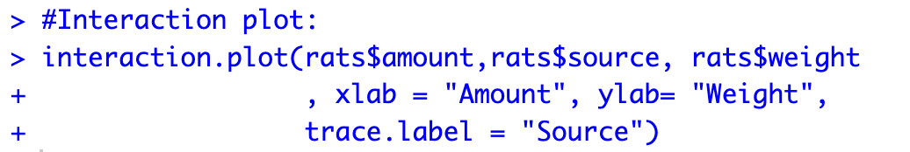

Slide 18
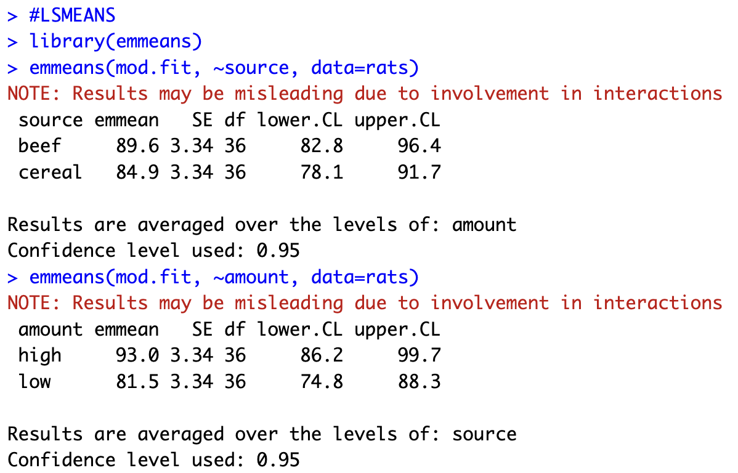
Means: Marginal Means
Note:
- Marginal Means are only shown for completeness.
- These are not recommended to report for this example.

Slide 19
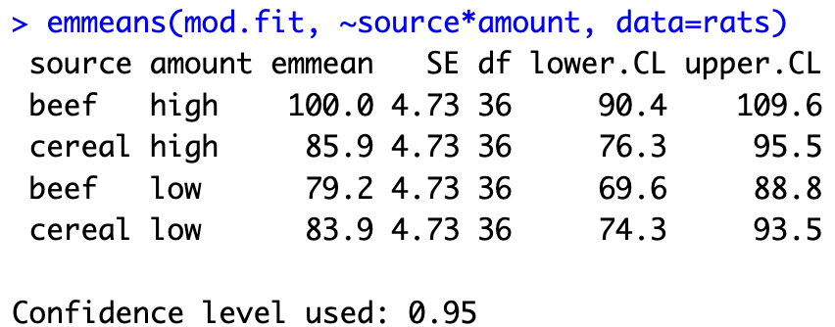
Means: Cell Means
Note:
- These are the correct means to be reported for this example.

Slide 20
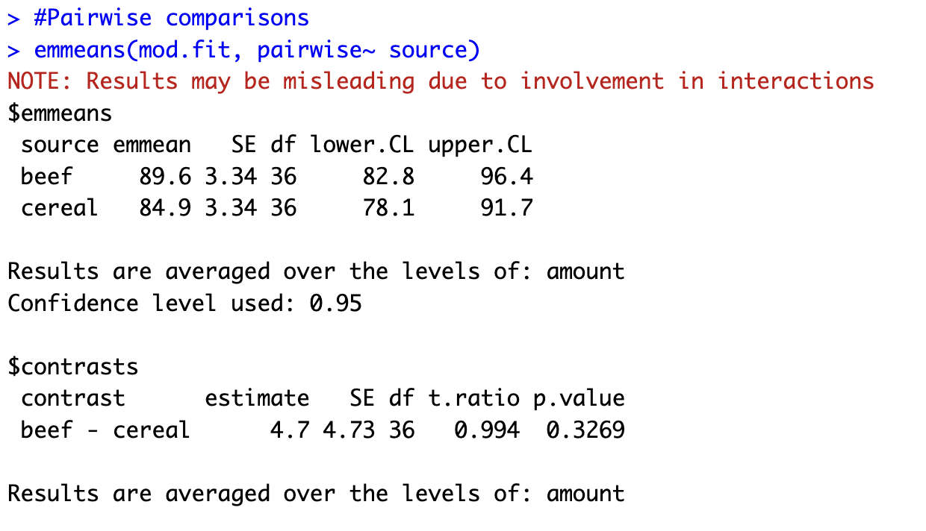
Pairwise Comparisons
Note:
- Only shown for completeness.
- These are not recommended to report for this example.

Slide 21
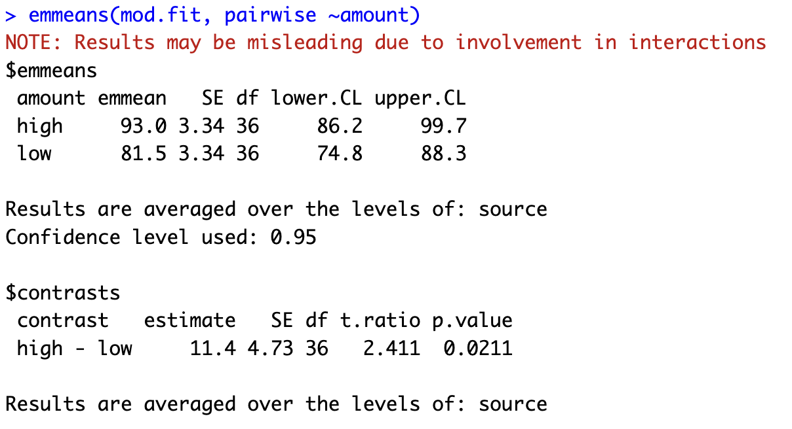
Pairwise Comparisons (…contd)
Note:
- Only shown for completeness.
- These are not recommended to report for this example.

Slide 22
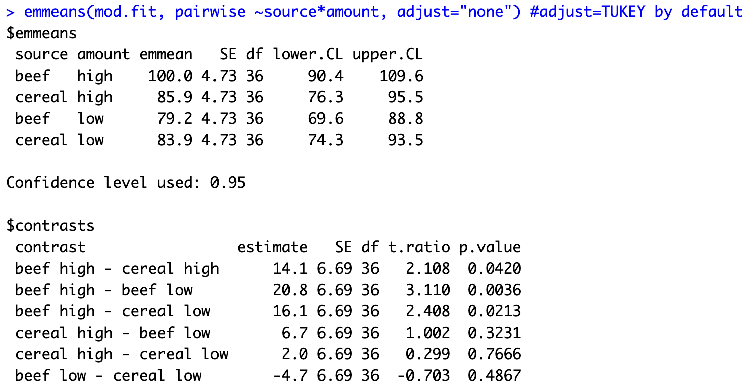
Pairwise Comparisons (…contd)

Slide 23
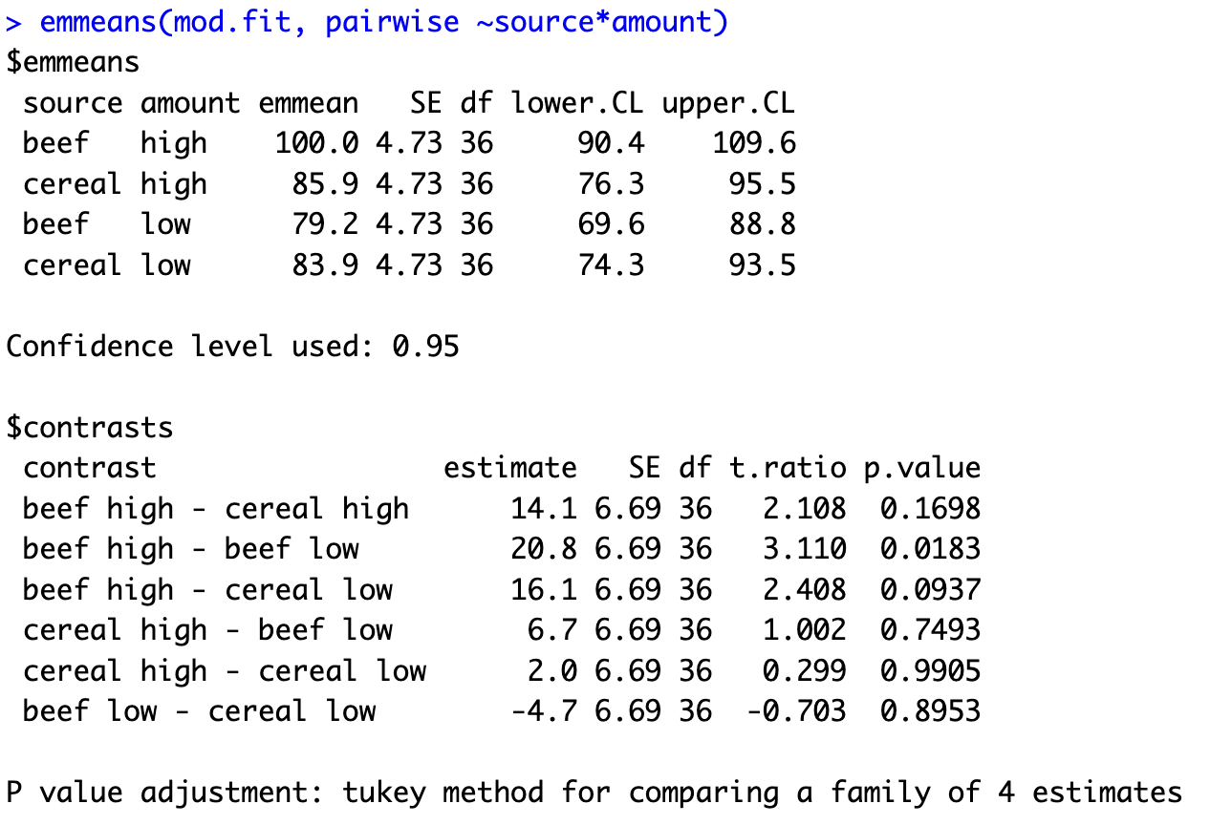

Slide 24
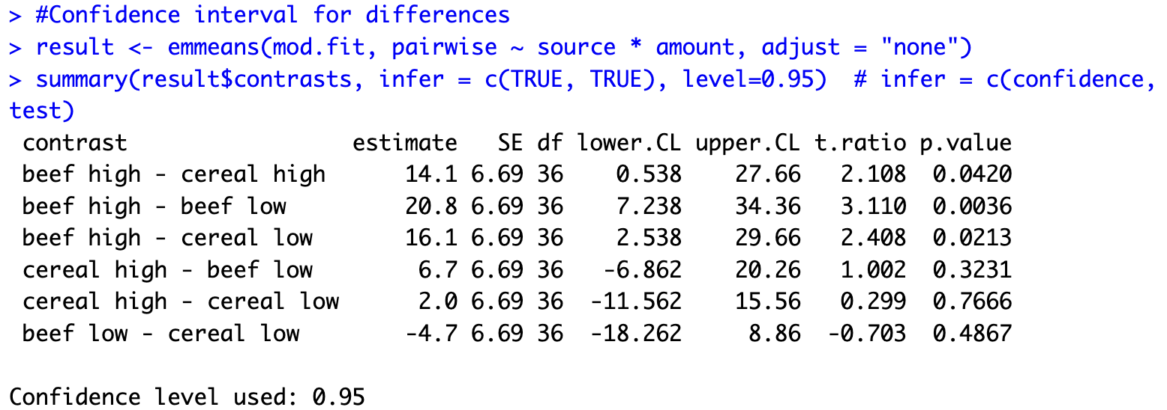
Pairwise Comparisons with Confidence Intervals

Slide 25
Summary
ANOVA
Interpreting ANOVA table
Main effects and Interactions effect
Interaction Plot
Estimated means, their differences and confidence intervals.

Slide 26
Thank you
Questions?

